Slide 1


NYC Yellow Cab Fare Prediction
Final Report
Ceyhun Sahinkaya
Data Science Career Track - Capstone Project #2
GitHub Project Link
Oct 2020

Slide 2
Table of Contents
Project Statement
2. Data Collection
3. Exploratory Data Analysis
4. Machine Learning
5. Conclusion

Slide 3

Section 1:
Project Statement

Slide 4
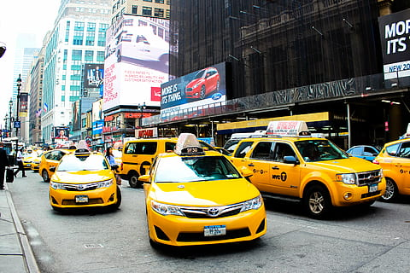
Project Flow
Statement
Main purpose of the project is to build a model predicting the fare amount of NYC yellow cabs

Slide 5
Section 2:
Data Collection

Slide 6
csv file of 55 million rows and 8 columns
Missing values were dropped.
Negative fare amounts were removed.
Rows with more than 4 passengers were removed
After all data cleaning, 1945783 rows removed.
Created Datetime variables.
Created Distance variable with coordinates
Notes:
https://visualpharm.com/

Slide 7
Section 3:
Exploratory
Data Analysis

Slide 8
Correlation
Passenger
Trip Distance
As one variable increases or decreases, how do the other variables respond, if at all?
Time

Slide 9
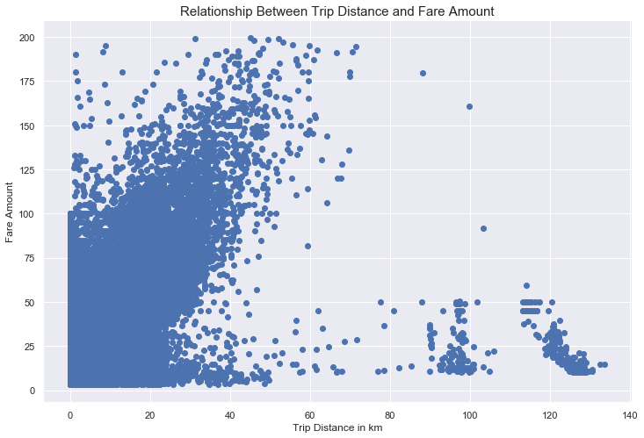
Trip Distance vs. Fare Amount
Most of the rides cost less than 25 dollars, average fare amount is $11.36 and median is $8.5.
Linear correlation between trip distance and Fare Amount

Slide 10
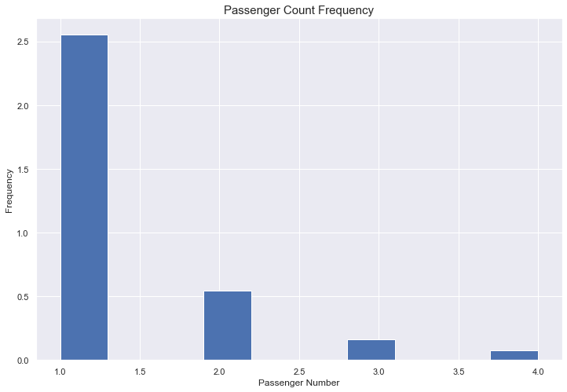
Passenger Number vs. Fare Amount
1 passenger is the most frequent and 4 passengers is least frequent.
Fare amount and passenger count is not correlated with each other.

Slide 11
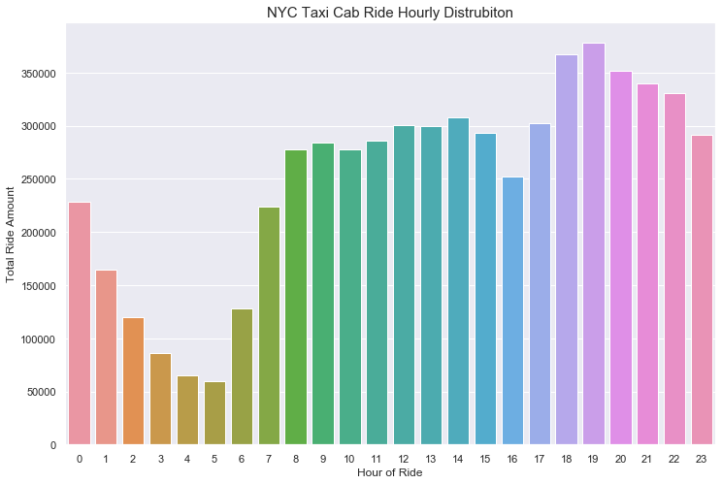
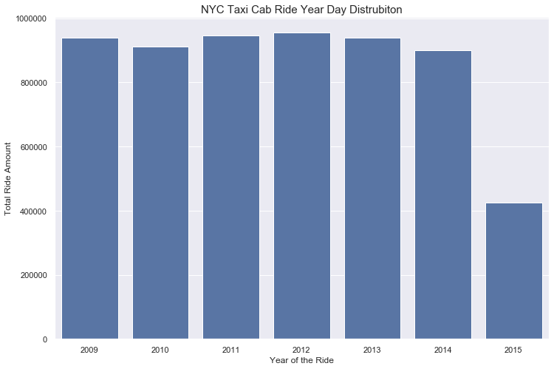
Datetime Variables vs. Fare Amount
The least busy time of the day for the taxi cabs in NYC is 4 AM and 5 AM, the busiest time is between 6 PM to 7 PM.
The 2015 ride amount is less than half from other years due to unknown reasons

Slide 12
Section 4:
Machine Learning

Slide 13
Machine Learning
XGBoost Regression
Light GBM
Linear Regression
The scientific study of algorithms and statistical models to effectively perform a specific task, relying on patterns and inference, as opposed to explicit instructions.
Random Forest

Slide 14
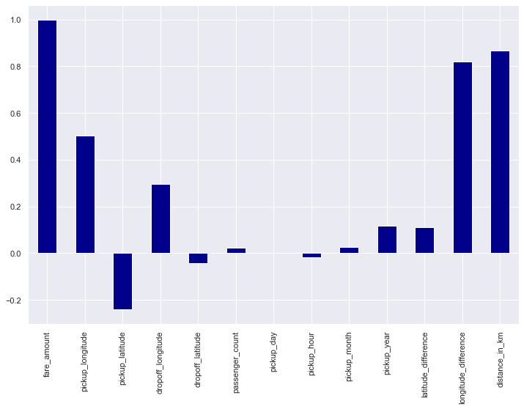
Linear Regression
The act of fitting a line to two or more variables to show a linear relationship between them.
Most important feature for Linear Regression is distance_in_km
Best RMSE | 4.488

Slide 15
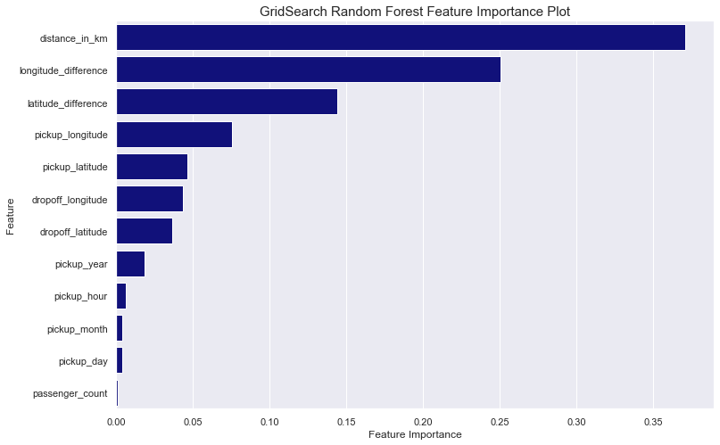

Random Forest
GridSearch is used to test different parameters and apply the best parameters for the model
The most important feature for our model is distance_in_km and longitude_difference
Best RMSE | 3.471

Slide 16
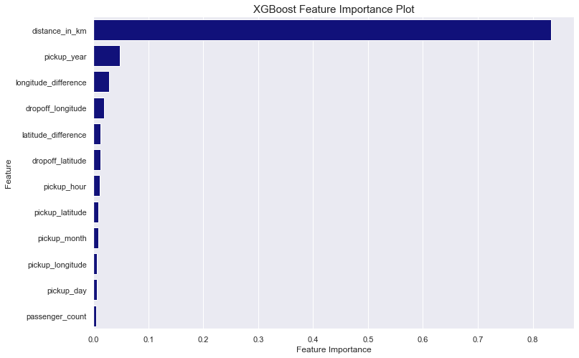
XGBoost Regression
Xgboost classifier is one of the most popular algorithms in the modern machine learning world due to its computing speed and performance.
The most important feature for our model is distance_in_km
Best RMSE | 3.371

Slide 17
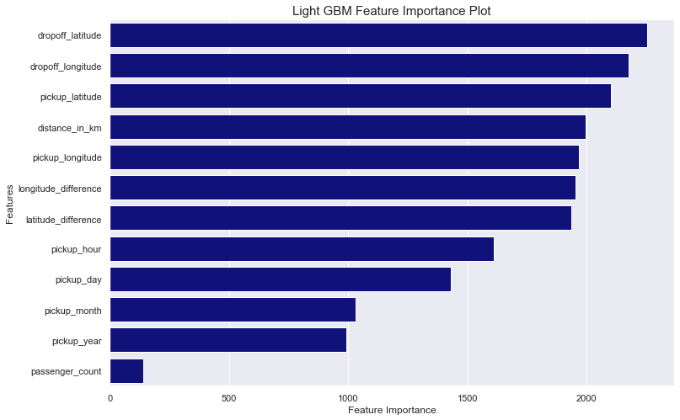
LightGBM Regression
XLight GBM can handle the large size of data and takes lower memory to run.
The best features for LightGBM Regression is dropoff_latitude, dropoff_longtitude, pickup_latitude
Best RMSE | 3.408

Slide 18
Section 5:
Conclusion

Slide 19
Conclusion
Most of the rides are with one passenger.
Most of the rides cost less than 25 dollars, average fare amount is
$ 11.36
Results
Average fare amount is increasing every year .
Models that predict NYC cab fare amount with RMSE $ 3.37 . The project can easily be applied to a business model. We can create an app telling the customers how much their cab ride will be based on their location, time and passenger count.
The busiest season is Spring for NYC yellow cabs and the ride amounts hit the bottom in July and August.
XGBoost Regression gives us the best RMSE score among the four models we tried in our project

